Slide 1



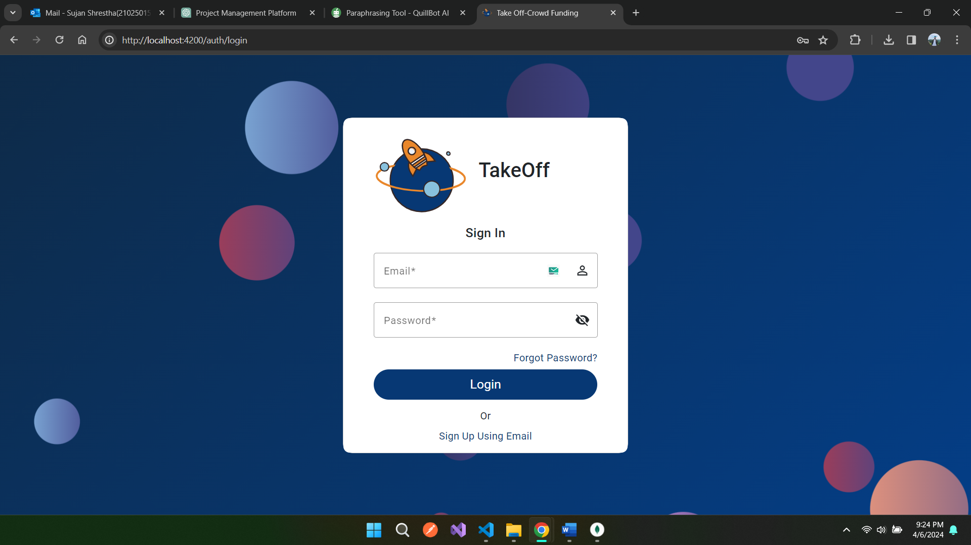
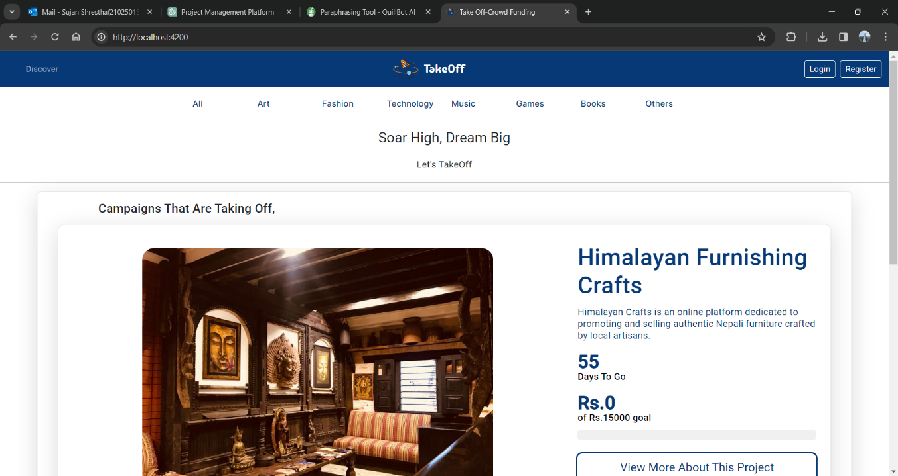
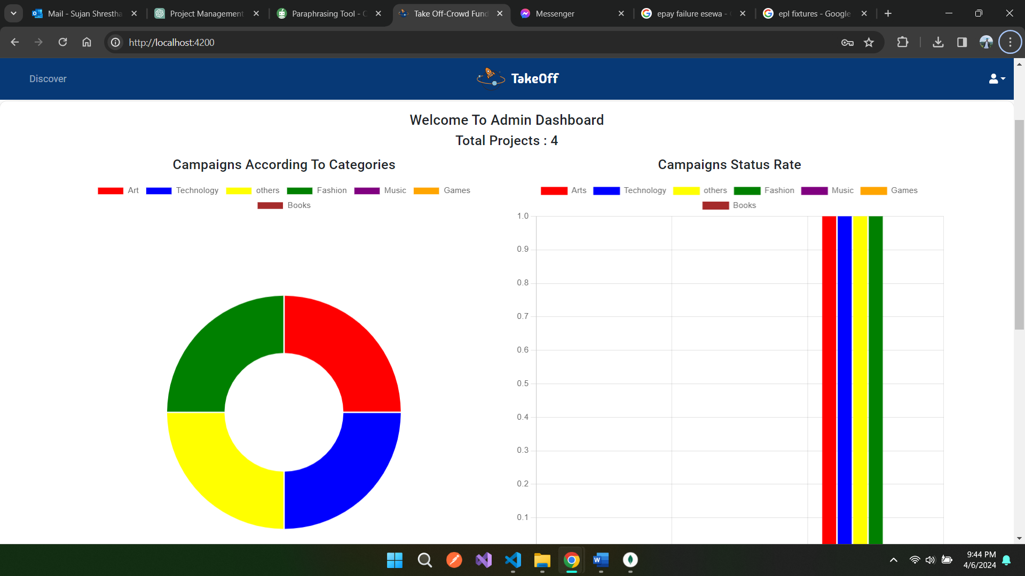

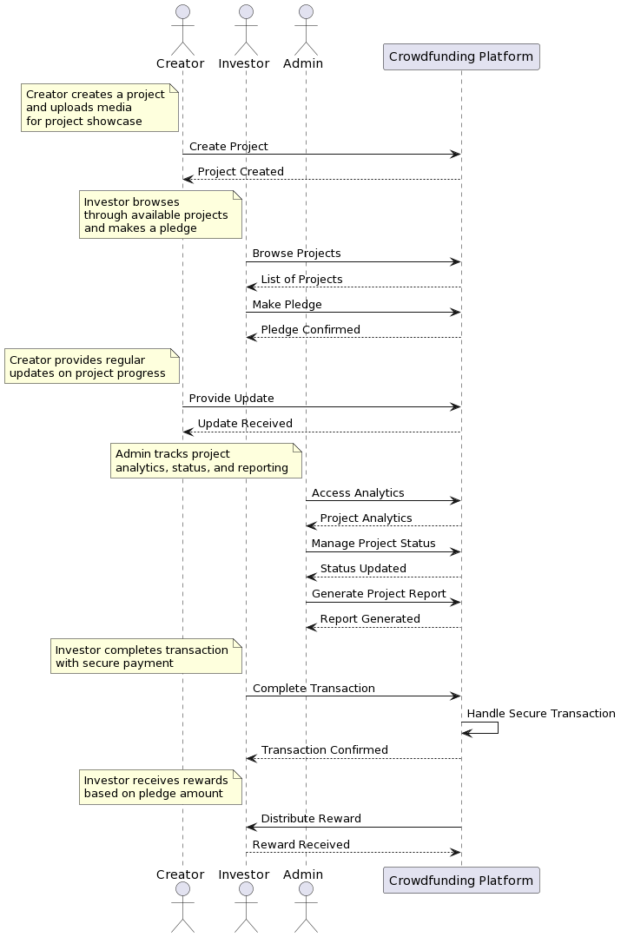
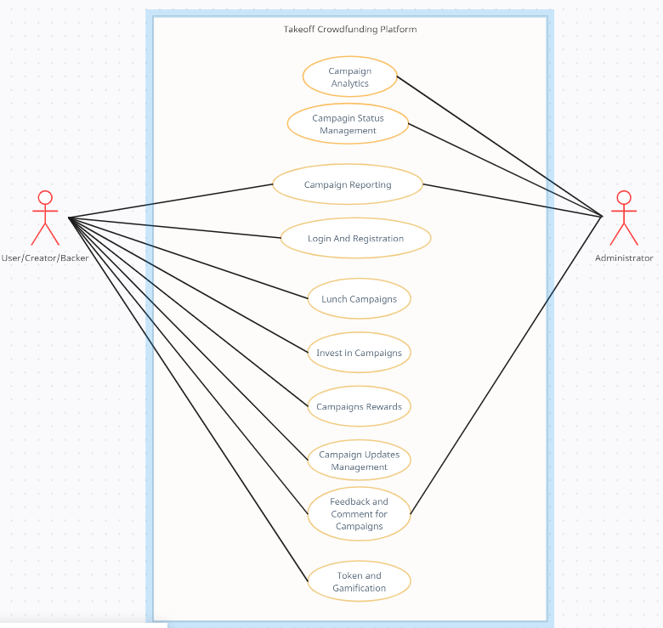

Takeoff: Online Crowdfunding Platform
Sujan Shrestha (NP000611)
BSc (Hons) Information Technology
Introduction
With the vision to revolutionize the way individuals and organizations can raise capital, this final year project dives into the implementation of hassle-free online crowdfunding platforms which can make the fundraising scenario more dynamic and inclusive in this sophistical era of innovation, the online crowdfunding platform can act as an economic elevation platform for many individuals and organizations out there wandering with different world changing ideas.
This project aims to establish a dynamic online crowdfunding platform that not only catalyzes the realization of creative ideas but also fosters sustainable startup ventures. By bridging the gap between visionary creators and enthusiastic investors, an online crowdfunding platform sets out to be the catalyst for transforming imaginative concepts into tangible successes. In a country where budding creators often struggle to find avenues for showcasing their innovative ideas, this crowdfunding platform in Nepal emerges as a beacon of opportunity. Our platform serves as a nexus for synergies between creators and investors, resulting in a harmonious convergence of visionary ideas and capital infusion.
Technology Used to Implement Takeoff Online Crowdfunding Platform
System Features
As the online crowdfunding platform is a web-based platform which will be hosted upon servers for users to interact with it efficiently through their browsers. I have decided to go for a MEAN stack selection which is a combination of multiple programming languages and techniques that provides full stack service for web development. The MEAN stack contains Mongo DB as a database, Express JS as a backend tool, Node JS as a server-side execution framework and Angular as the frontend tool. This stack is used by different professionals as it is highly efficient for web development. Overall programming techniques will include HTML, CSS, JavaScript, Typescript and different libraries and frameworks of mentioned programming languages.
User Authentication and Authorization via Email
Campaign Creation
Investment in Campaign
Reward System
Campaign Updates and Feedback system
Project Analytics for Administration
Token And Gamification
Esewa Payment Gateway Integration
Objective
Conclusion
Empower Startups: Facilitate startup ventures in Nepal by providing them with a user-friendly platform to present their innovative ideas and secure the necessary funding for launch and growth.
Enhance Access to Funding: Eliminate traditional barriers to funding by offering a streamlined online channel that allows creators to present their projects directly to a wide range of potential backers.
Boost Creativity: Encourage creators to test the market with their ideas by offering a space where they can gather feedback, refine their concepts, and refine their pitches to attract investors.
Connect Creators and Investors: Forge connections between creators and investors from diverse backgrounds, fostering an ecosystem of collaboration and support that enhances the potential for success.
Facilitate Informed Decision-Making: Provide investors with comprehensive project details, enabling them to make informed investment choices based on well-documented business pitches.
The successful culmination of this crowdfunding project signifies the attainment of a sophisticated and user-centric platform. Meticulous testing and evaluation were undertaken throughout the development phase to ensure the platform's key components—functionality, usability, and effectiveness—were finely tuned. Extensive research paved the way, ensuring alignment with user needs and preferences. The platform emerged as a showcase of innovation, offering creators a robust space for their campaigns while providing backers with seamless investment opportunities.
During the project's evolution, user experience was prioritized, resulting in an intuitive interface that fosters effortless navigation and interaction. Rigorous testing, including user acceptance testing (UAT), facilitated the identification and resolution of any issues, guaranteeing smooth operation under various conditions. Feedback collected during UAT further refined the platform's usability, enhancing its overall performance and user satisfaction. Looking ahead, continued research could unveil deeper insights into user preferences, potentially unlocking avenues for further optimization and feature enhancements.
Screenshots of the MGC System
Fig: Login Page
Fig: Dashboard
Fig: Admin Dashboard
Takeoff-Sequence Diagram
Takeoff-Use Case Diagram
Takeoff Online Crowdfunding Platform
Developed by: Sujan Shrestha (NP000611)
BSc (Hons) in Information Technology
Intake Code: NP3F2304IT
Supervised by: Mr. Bishal Prasad Kurmi
2nd Marker: Ms. Ratan Raj Pant

